Slide 1
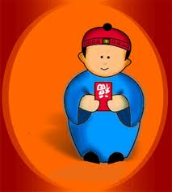

Happy Chinese New Year!
Saturday, February 5 2011
Join in celebrating a new Year of good fortune, health and happiness.
The Muskoka Multicultural Association in partnership with Bethune House is hosting a Chinese New Years Potluck.
Enjoy traditional Chinese dish’s and socialize with old and new friends.
新年快乐
Date/Time:
Where:
Location:
Cost of event:
Contact:
Transportation is available
MUSKOKA MULTICULTURAL ASSOCIATION

